Slide 1
FINANCIAL RISK MANAGEMENT - TCHE409
Nguyen Thu Hang
nguyenthuhang.cs2@ftu.edu.vn

Slide 2
Outline
Chapter 1: Overview of Financial Risk Management
Chapter 2: Forward and Futures and Applications Chapter 3: Forward and Futures Pricing
Chapter 4: Swap contracts, pricing and applications
Chapter 5 : Options and applications
Chapter 6: Option Pricing and Module Wrap-up

Slide 3
Assessment
Performance: 10%
Mid-term test: 30% MCQ + Written exam (60 minutes)
Final term test : 60% MCQ + Written exam (60 minutes)

Slide 4
Course material
Options, Futures and other derivatives, 10e by John Hull (2018):
Main contents: Chapter 1,2,3,4,5,7,10,11,12 and 13.

Slide 5
CHAPTER 1
INTRODUCTION TO RISK MANAGEMENT

Slide 6
Outline
Interest rate, return and risk
Interest rate
Return
Risk
Risk preference
Risk management
Impact of financial risk management
Derivatives
- Concepts
- Ways derivatives are used

Slide 7

Interest rate
For a simple loan
For a fixed payment loan
For a coupon bond:

Slide 8
Interest rate and time value of money
The future value of PV after n years:
Interest is paid once per year
Interest is paid m time per year
R : discrete /periodic interest rate
Interest is paid continuously:
→ R : continuous interest rate → Denoted as Rc or r in the following slides

Slide 9
Effective annual rate:
Ex: A bank quotes an interest of 8% per annum (called simple annual rate) with quarterly compounding. What is the effective annual rate (equivalent annual interest rate)?

Slide 10

Continuous compounding rate
Ex: A bank quotes an interest of 8% per annum (called simple annual rate) with quarterly compounding. What is the equivalent rate with continuous compounding?

Slide 11
Effective annual rate and continuous compounding rate

Slide 12
Problems
What rate of interest with continuous compounding is equivalent to 15% per annum with monthly compounding?
A deposit account pays 12% per annum with continuous compounding, but actually paid quarterly. How much interest will be paid each quarter on a $10000 deposit?
Techcombank quotes an interest rate of 14% per annum compounded quarterly. What are equivalent annual and continuous rates?

Slide 13
4. What rate of interest with continuous compounding is equivalent to 15% per annum with monthly compounding?
5. A deposit account pays 12% per annum with continuous compounding, but interest is actually paid quarterly. How much interest will be paid each quarter on a $10,000 deposit.

Slide 14
Bond pricing
With a periodic interest rate
With a continuous interest rate
With different continuous interest rates for each payment:

Slide 15
Ex: A 2 year T-bond with a principal of $100 provides coupon at the rate of 6% per annum semiannually. Calculate the theoretical price of the bond?
Maturity | Zero rate (%) (continuously compounded)
0.5 1.0 1.5 2.0 | 5.0 5.8 6.4 6.8

Slide 16
Bond Yield
The bond yield is the discount rate that makes the present value of the cash flows on the bond equal to the market price of the bond
Suppose that the market price of the bond in our example equals its theoretical price of 98.39
The bond yield (continuously compounded) is given by solving
to get y=0.0676 or 6.76%.

Slide 17
Problem
6. Suppose that 6-month, 12-month, 18-month, 24-month and 30-month zero rates are respectively, 4%, 4.2%, 4.4%, 4.6% and 4.8% per annum, with continuous compounding. Estimate the price of a bond with a face value of 100 that will mature in 30 months and pays a coupon of 4% per annum semiannually.

Slide 18
Zero Rates
A zero rate (or spot rate), for maturity T is the rate of interest earned on an investment that provides a payoff only at time T

Slide 19
Calculate Treasury zero rates- Bootstrap method
Bond
Time to
Annual
Bond Cash
Principal
Maturity
Coupon
Price
(dollars)
(years)
(dollars)
(dollars)
100
0.25
0
97.5
100
0.50
0
94.9
100
1.00
0
90.0
100
1.50
8
96.0
100
2.00
12
101.6

Slide 20
7. Calculate Treasury zero rates
Bond
Time to
Annual
Bond Cash
Principal
Maturity
Coupon
Price
(dollars)
(years)
(dollars)
(dollars)
100
0.50
0
98
100
1.00
0
95
100
1.50
6.2
101
100
2.00
8.0
104
Half the stated coupon is assumed to be paid every six months
Calculate zero rates for maturities of 6 months, 12 months, 18 months and 24 months.

Slide 21
Forward Rates
The forward rate is the future zero rate implied by today’s term structure of interest rates

Slide 22
Calculation of Forward Rates
n-year
Forward Rate
zero rate
n
for
th Year
n
Year (
)
(% per annum)
(% per annum)
1
3.0
2
4.0
5.0
3
4.6
5.8
4
5.0
6.2
5
5.3
6.5

Slide 23
Formula for Forward Rates
Suppose that the zero rates for time periods T₁ and T₂ are R₁ and R₂ with both rates continuously compounded.
The forward rate for the period between times T₁ and T₂ is

Slide 24
Problem
8. The 6-month, 12-month, 18-month and 24-month zero rates are 4%, 4,5%, 4,75% and 5%, with semiannual compounding.
What are the rates with continuous compounding?
What is the forward rate for the 6-month period beginning in 18 months?

Slide 25
9. The following table gives the prices of bonds
Bond
Time to
Annual
Bond Cash
Principal
Maturity
Coupon
Price
(dollars)
(years)
(dollars)
(dollars)
100
0.50
0
98
100
1.00
0
95
100
1.50
6.2
101
100
2.00
8.0
104
Half the stated coupon is assumed to be paid every six months

Slide 26
Calculate zero rates for maturities of 6 months, 12 months, 18 months and 24 months.
What are the forward rates for the following periods: 6 months to 12 months, 12 months to 18 months and 18 months to 24 months.
Estimate the price of 2 –year bond providing a semiannual coupon of 7% per annum.

Slide 27
10. Which security has a higher effective annual interest rate?
(a) A three-month T-bill selling at $97, 645 with face value of $100, 000.
(b) A coupon bond selling at par and paying a 10% coupon semi-annually.

Slide 28
Return and Risk
Defining Financial Risk & Return
Define return as the total gain or loss experienced on an investment over a given period of time. → How to measure return?
Define risk as the variability of returns associated with a given asset. → How to measure risk?

Slide 29
Measures of return
Simple return: Return measured as the change in an asset's value plus any cash distributions (dividends or interest payments). (Holding period return)
Continuously compounded return: see in advanced materials
Where P_{t+1} = price (value) of asset at time t+1;
P_{t} = price (value) of asset at time t;
C_{t+1} = cash flow paid by time t+1
Calculate yearly, monthly, daily holding period returns (HPR) → Yearly return, monthly return, weekly return and daily return.
Notes:
Simple return

Slide 30
Simple return for a single and multi-periods (using dividend-adjusted prices)
Simple return for a period
Simple return for multi-periods

Slide 31
- Compute the annualized return from a one -month return:
Compute the annualized return from a one-week return

Slide 32
Continuously compounded return
rt : monthly continuous return.
Rt: monthly simple return

Slide 33
Compute the annualized return from a one -month return/ a one week return:

Slide 34
Realized Return Versus Expected Return
Realized (ex post) return is easily computed:
Calculate yearly, monthly, daily holding period returns (HPR)
Real financial decisions, however, are based on expected (ex ante) returns, not realized returns:
Realized return (at best) useful in estimating expected return
Can specify conditional or unconditional expected returns
Conditional expected return: “If the economy improves next year, the asset’s return is expected to be 12%.” Or could be conditional on return on overall stock market.
Unconditional expected return: “The asset’s return next year is expected to be 12%.”

Slide 35
EXAMPLE 1: Expected Return
What is the expected return on an Exxon-Mobil bond if the return is 12% two-thirds of the time and 8% one-third of the time?
Solution
The expected return is 10.68%.
R^{e} = p₁R₁ + p₂R₂
where
p₁ = probability of occurrence of return 1 = 2/3 = .67
R₁ = return in state 1 = 12% = 0.12
p₂ = probability of occurrence return 2 = 1/3 = .33
R₂ = return in state 2 = 8% = 0.08
Thus
R^{e} = (.67)(0.12) + (.33)(0.08) = 0.1068 = 10.68%

Slide 36
Expected return – General equation
E(R) =Expected return
n = Number of states
R_{i}= return in state i
p_{i}= Probability of occurrence of state i

Slide 37
It’s rarely feasible to specify the full distribution of possible returns.
Use the average of historical returns as a measure of expected return:
Generate expected return based on a specific asset pricing model, such as CAPM

Slide 38
Measures of Risk
Standard deviation: is a measure of the dispersion of a set of returns around their expected value.
Beta: (systematic risk) measures the degree to which the stock moves with the overall market.
Volatility

Slide 39
EXAMPLE 2: Standard Deviation (a)
Consider the following two companies and their forecasted returns for the upcoming year:

Slide 40
EXAMPLE 2: Standard Deviation (b)
What is the standard deviation of the returns on the Fly-by-Night Airlines stock and Feet-on-the-Ground Bus Company, with the return outcomes and probabilities described above? Of these two stocks, which is riskier?

Slide 41
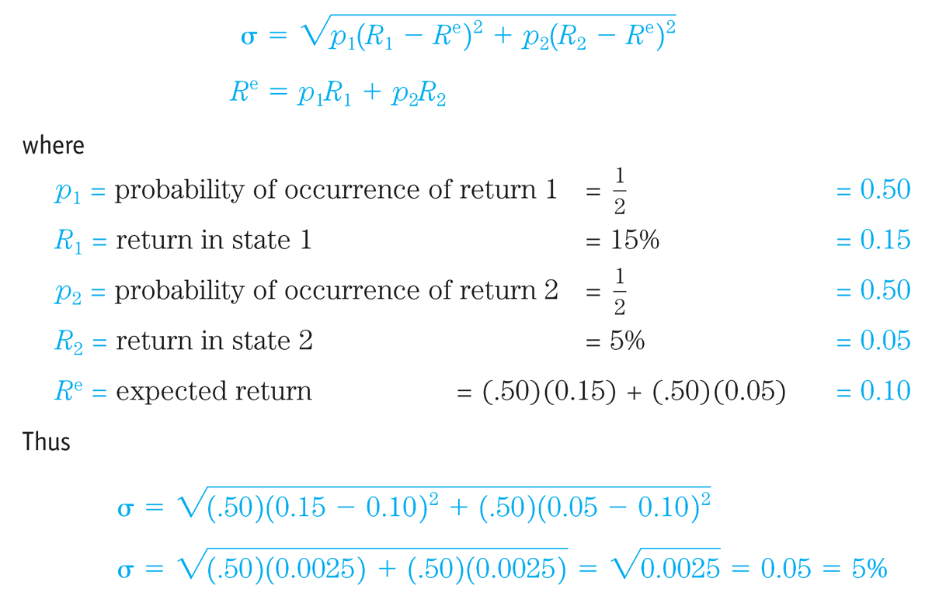
EXAMPLE 2: Standard Deviation (c)
Solution
Fly-by-Night Airlines has a standard deviation of returns of 5%.

Slide 42
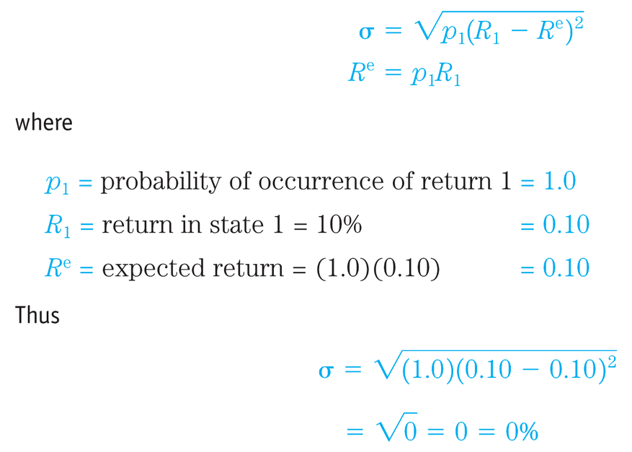
EXAMPLE 2: Standard Deviation (d)
Feet-on-the-Ground Bus Company has a standard deviation of returns of 0%.

Slide 43
EXAMPLE 2: Standard Deviation (e)
Fly-by-Night Airlines has a standard deviation of returns of 5%; Feet-on-the-Ground Bus Company has a standard deviation of returns of 0%
Clearly, Fly-by-Night Airlines is a riskier stock because its standard deviation of returns of 5% is higher than the zero standard deviation of returns for Feet-on-the-Ground Bus Company, which has a certain return

Slide 44
Standard deviation- general equation
It’s rarely feasible to specify the full distribution of possible returns and expected variance.
Must know all possible outcomes & associated probabilities
Instead, analysts usually gather historical data and use these to generate expected return and variance

Slide 45
Uncorrected sample standard deviation/ standard deviation of the sample
Corrected sample standard deviation

Slide 46
Return and risk of a portfolio

Slide 47
The Historical Trade-Off Between Risk & Return (1926-2000)
Portfolio | Average Annual Rate of Return |  | Average Risk Premium (Extra Return vs. Treasury Bills)
 | Nominal | Real
Treasury Bills | 3.9 | 0.8 | 0
Government Bonds | 5.7 | 2.7 | 1.8
Corporate Bonds | 6.0 | 3.0 | 2.1
Common Stocks (S&P 500) | 13.0 | 9.7 | 9.1
Small Firm Common Stocks | 17.3 | 13.8 | 13.4
Figures are in percent per year.

Slide 48
The Historical Trade-Off Between Risk & Return (1926-2000)
Portfolio | Standard Deviation | Variance
Treasury Bills | 3.2 | 10.1
Government Bonds | 9.4 | 88.7
Corporate Bonds | 8.7 | 75.5
Common Stocks (S&P 500) | 20.2 | 406.9
Small Firm Common Stocks | 33.4 | 1118.4

Slide 49
Real future value of $ 1 invested in 1926
Real returns
660
267
6.6
5.0
1.7
Index
1
Year
Source: Ibbotson Associates
Notes:
13

Slide 50
Historical returns, U.S., 1926-2000
%
Year
Source: Ibbotson Associates
Notes:
14

Slide 51
Average risk by period
Period (NYSE) | Market St.Dev.(σ_{m})
1926-1930 | 21.7
1931-1940 | 37.8
1941-1950 | 14.0
1951-1960 | 12.1
1961-1970 | 13.0
1971-1980 | 15.8
1981-1990 | 16.5
1991-2000 | 13.4

Slide 52
Histogram of Return on Portfolio of Large Company Stocks 1926-2000
Number of years
Return %
Notes:
Risk measurement

Slide 53
Histogram of Return on Portfolio of Large Company Stocks, 1926-2000
Notes:
A bell shaped curve

Slide 54
Normal distribution
x – 3s x – 2s x – s x x + s x +2s x + 3s
Approximately 68% of the measurements
Approximately 95% of the measurements
Approximately 99.7% of the measurements

Slide 55
Two Assets With Same Expected Return But Different (Continuous) Probability Distributions
Stock 1
Probability Density
Stock 2
0 5 6 7 8 9 10 11 12 13 14 15
Return %

Slide 56
The Volatility
The volatility is the standard deviation of the continuously compounded rate of return in 1 year
The standard deviation of the return in time Δt is
If a stock price is $50 and its volatility is 25% per year what is the standard deviation of the price change in one day?

Slide 57
Estimating Volatility from Historical Data
Take observations S₀, S₁, . . . , S_{n} at intervals of τ years
Calculate the continuously compounded return in each interval as:
Calculate the standard deviation, s , of the u_{i}´s
The historical volatility estimate is:

Slide 58
Nature of Volatility
Volatility is usually much greater when the market is open (i.e. the asset is trading) than when it is closed
For this reason time is usually measured in “trading days” not calendar days when options are valued

Slide 59
Risk Preferences: Comparing Two Assets With The Same Expected Return
Stocks 1 & 2 both have an expected return of 10%.
Both offer 10% return in an average economy
Stock 2 would have higher return if economy booms
Stock 1 has lower return variability; does better in bad times
Whether an investor would consider them equally attractive depends on his/her degree of risk aversion (utility function)
Risk averse investor prefers lower variability for given E(R)
Risk seeking investor prefers higher variability for given E(R)
Risk neutral investor is indifferent about variability
Finance theory, common sense, and observed behavior all suggest investors are risk averse
If two assets offer equal E(R), will pick one with less variability
Must be offered higher E(R) to accept higher variability

Slide 60
II. Risk management:
Use derivatives to decrease the volatility of future cash flows

Slide 61
The Nature of Derivatives
A derivative is an instrument whose value depends on the values of other more basic underlying variables
Futures Contracts
Forward Contracts
Swaps
Options
Notes:
2

Slide 62
Forward Contracts
A forward contract is an agreement to buy or sell an asset at a certain time in the future for a certain price.
A forward contracts are traded in the OTC market.
Forward contracts are popular on currencies and interest rates.
There is no daily settlement (but collateral may have to be posted). At the end of the life of the contract one party buys the asset for the agreed price from the other party.
By contrast in a spot contract there is an agreement to buy or sell the asset immediately (or within a very short period of time).

Slide 63
Futures Contracts
A futures contract is an agreement to buy or sell an asset at a certain time in the future for a certain price
Available on a wide range of underlying assets
Traded in futures exchanges
A range of delivery dates.
Futures contracts are standardized by the exchange
Settled daily
Notes:
7

Slide 64
Delivery
Delivery or final cash settlement rarely takes place with futures contracts.→ They are normally closed out before maturity.
If a futures contract is not closed out before maturity, it is usually settled by delivering the assets underlying the contract. When there are alternatives about what is delivered, where it is delivered, and when it is delivered, the party with the short position chooses.
A few contracts (for example, those on stock indices and Eurodollars) are settled in cash
When there is cash settlement contracts are traded until a predetermined time. All are then declared to be closed out.

Slide 65
Margins
A margin is cash or marketable securities deposited by an investor with his or her broker
The balance in the margin account is adjusted to reflect daily settlement
Margins minimize the possibility of a loss through a default on a contract

Slide 66
Example of a Futures Trade
An investor takes a long position in 2 December gold futures contracts
contract size is 100 oz.
futures price is US$1250
margin requirement is US$6,000/contract (US$12,000 in total)
maintenance margin is US$4,500/contract (US$9,000 in total)

Slide 67
Operation of margin account

Slide 68
Profit from a Long Forward or Futures Position
Profit
Price of Underlying
at Maturity
Notes:
14

Slide 69
Profit from a Short Forward or Futures Position
Profit
Price of Underlying
at Maturity
Notes:
15

Slide 70
Forward Contracts vs Futures Contracts
Forward | Futures
Private contract between two parties | Traded on an exchange
Not standardized | Standardized
Usually one specified delivery date | Range of delivery dates
Settled at end of contract | Settled daily
Delivery or final settlement usual | Usually closed out prior to maturity
Some credit risk | Virtually no credit risk

Slide 71
Foreign Exchange Quotes
Futures exchange rates are quoted as the number of USD per unit of the foreign currency
Forward exchange rates are quoted in the same way as spot exchange rates. This means that GBP, EUR, AUD, and NZD are USD per unit of foreign currency. Other currencies (e.g., CAD and JPY) are quoted as units of the foreign currency per USD.
Notes:
17

Slide 72
Problems
10. A trader enters into a one-year short forward contract to sell an asset for $60 when the spot price is $58. The spot price in one year proves to be $63. What is the trader's gain or loss?
11. A company enters into a long futures contract to buy 1,000 units of a commodity for $20 per unit. The initial margin is $6,000 and the maintenance margin is $4,000. What futures price will allow $2,000 to be withdrawn from the margin account?

Slide 73
Problems
12. A company enters into a short futures contract to sell 50,000 pounds of cotton for 70 cents per pound. The initial margin is $4,000 and the maintenance margin is $3,000. What is the futures price above which there will be a margin call?

Slide 74
Options
A call option is an option to buy a certain asset (underlying asset) by a certain date (expiration date or maturity) for a certain price (the strike price or exercise price)
A put option is an option to sell a certain asset (underlying asset) by a certain date (expiration date or maturity) for a certain price (the strike price or exercise price)

Slide 75
Options vs Futures/Forwards
A futures/forward contract gives the holder the obligation to buy or sell at a certain price
An option gives the holder the right to buy or sell at a certain price

Slide 76
American vs European Options
An American option can be exercised at any time during its life
A European option can be exercised only at maturity

Slide 77
Option Positions
Long call
Long put
Short call
Short put

Slide 78
European Call option-example (a)
A European call option with a strike price of $100 to purchase 100 shares of a certain stock. The current stock price is $98, the expiration date of the option is in 4 months, and the price of an option to purchase one share is $5.

Slide 79
European Call option-example (b)
On the expiration date,
- If ST(stock price = $115) is above $100 → The investor will choose to exercise →Makes a gain of $15 per share or $1500 → A net profit of $1000.
- If ST is less than $100 → The investor will choose not to exercise. → Losses $5 per share of $500.

Slide 80
Long Call
Profit from buying one European call option: option price = $5, strike price = $100.
30
Profit ($)
20
10
Terminal
stock price ($)
70
80
90
100
0
-5
110
120
130

Slide 81
Short Call
Profit from writing one European call option: option price = $5, strike price = $100
Profit ($)
5
110
120
130
0
70
80
90
100
Terminal
stock price ($)
-10
-20
-30

Slide 82
European put option-example (a)
A European put option with a strike price of $70 to sell 100 shares of a certain stock. The current stock price is $65, the expiration date of the option is in 3 months, and the price of an option to sell one share is $7.

Slide 83
European put option-example (b)
On the expiration date,
- If ST(stock price) is below $70 (let’s say $55)→ The investor will choose to exercise →Makes a gain of $15 per share or $1500 → A net profit of $800.
- If ST is above $70 → The investor will choose not to exercise. → Losses $7 per share of $700.

Slide 84
Long Put
Profit from buying a European put option: option price = $7, strike price = $70
30
Profit ($)
20
10
Terminal
stock price ($)
0
40
50
60
70
80
90
100
-7

Slide 85
Short Put
Profit from writing a European put option: option price = $7, strike price = $70
Profit ($)
Terminal
stock price ($)
7
40
50
60
0
70
80
90
100
-10
-20
-30

Slide 86
Payoff of the four positions on the date of maturity T

Slide 87
Google Option Prices (July 17, 2009; Stock Price=430.25)

Slide 88
Exchanges Trading Options
Chicago Board Options Exchange
International Securities Exchange
NYSE Euronext
Eurex (Europe)
and many more (see list at end of book)

Slide 89
Problems
13. A trader buys 100 European call options with a strike price of $20 and a time to maturity of one year. The cost of each option is $2. The price of the underlying asset proves to be $25 in one year. What is the trader's gain or loss?
14. A trader sells 100 European put options with a strike price of $50 and a time to maturity of six months. The price received for each option is $4. The price of the underlying asset is $41 in six months. What is the trader's gain or loss?

Slide 90
Problems
15. The price of a stock is $36 and the price of a three-month call option on the stock with a strike price of $36 is $3.60. Suppose a trader has $3,600 to invest and is trying to choose between buying 1,000 options and 100 shares of stock. How high does the stock price have to rise for an investment in options to be as profitable as an investment in the stock?
16. A one-year call option on a stock with a strike price of $30 costs $3; a one-year put option on the stock with a strike price of $30 costs $4. Suppose that a trader buys two call options and one put option.
(i) What is the breakeven stock price, above which the trader makes a profit? ……….
(ii) What is the breakeven stock price below which the trader makes a profit? ……….

Slide 91
SWAPS
A swap is an agreement to exchange cash flows at specified future times according to certain specified rules.
See in Chapter 4.

Slide 92
Ways Derivatives are Used
To hedge risks
To speculate (take a view on the future direction of the market)
To lock in an arbitrage profit
To change the nature of a liability
To change the nature of an investment without incurring the costs of selling one portfolio and buying another
Notes:
4

Slide 93
Hedging Examples
A US company will pay £10 million for imports from Britain in 3 months and decides to hedge using a long position in a forward contract
An investor owns 1,000 Microsoft shares currently worth $28 per share. A two-month put with a strike price of $27.50 costs $1. The investor decides to hedge by longing put options.
Notes:
16

Slide 94
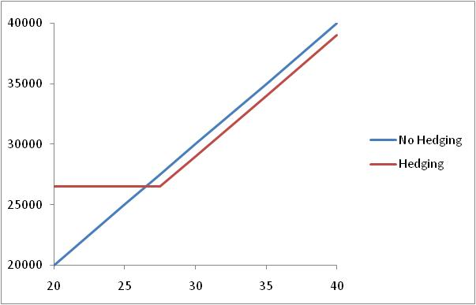
Value of Microsoft Shares with and without Hedging (Fig 1.4, page 12)

Slide 95
Speculation Example
An investor with $2,000 to invest feels that a stock price will increase over the next 2 months. The current stock price is $20 and the price of a 2-month call option with a strike of $22.50 is $1
What are the alternative strategies? What are their returns?
Notes:
17

Slide 97
Problems
17. You would like to speculate on a rise in the price of a certain stock. The current stock price is $29 and a 3-month call with a strike price of $30 costs $2.90. You have $5,800 to invest. Identify two alternative investment strategies, one in the stock and the other in an option on the stock. What are the potential returns of the strategies?
18. Describe the profit from the following portfolio: a long forward contract on an asset and a long European put option on the asset with the same maturity as the forward contract and a strike price that is equal to the forward price of the asset at the time the portfolio is set up.

Slide 98
Arbitrage Example
A stock price is quoted as £100 in London and $162 in New York
The current exchange rate is 1.6500
What is the arbitrage opportunity?

Slide 99
The Law of One Price and arbitrage
In a competitive market, if two assets are equivalent, they will tend to have the same market price.
The Law of One Price is enforced by a process called arbitrage.
Ex: if the price of gold in Tokyo is $1200 per ounce, what is its price in Seoul?

